Slide 1
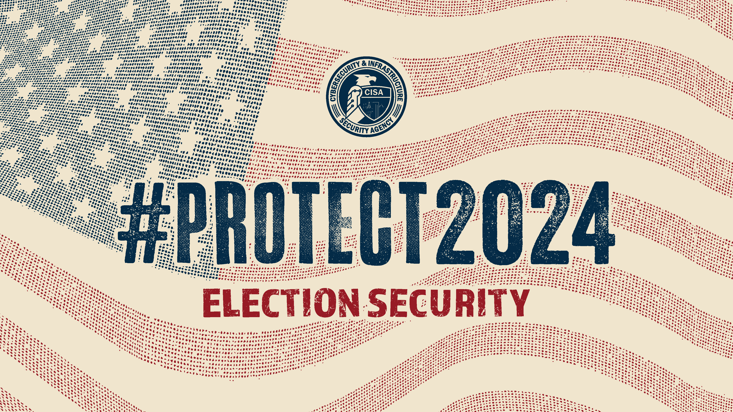
DHS Color Palette Per OPA RGB Colors
Use Arial Font For All Text
Change Presenter’s Name
In Slide Master
Notes:
Change Presenter’s Name and Date in Slide Master view.

Slide 2
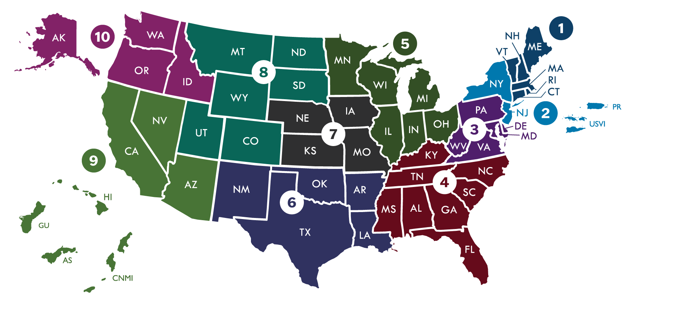
CISA & Election Infrastructure
The Cybersecurity and Infrastructure Security Agency’s (CISA) mission is to help secure our nation’s critical infrastructure.
In January 2017, the Department of Homeland Security (DHS) designated election infrastructure as critical infrastructure.
Through our CISA field staff across the country and our security experts at CISA headquarters, CISA offers a range of voluntary, no-cost services and support to stakeholders to help ensure the security and resiliency of election infrastructure.
CISA’s Regional Election Security Advisors help ensure maximum support to the election community through tailored support to meet unique state and local needs.
CISA’s Regional Field Staff

Slide 3
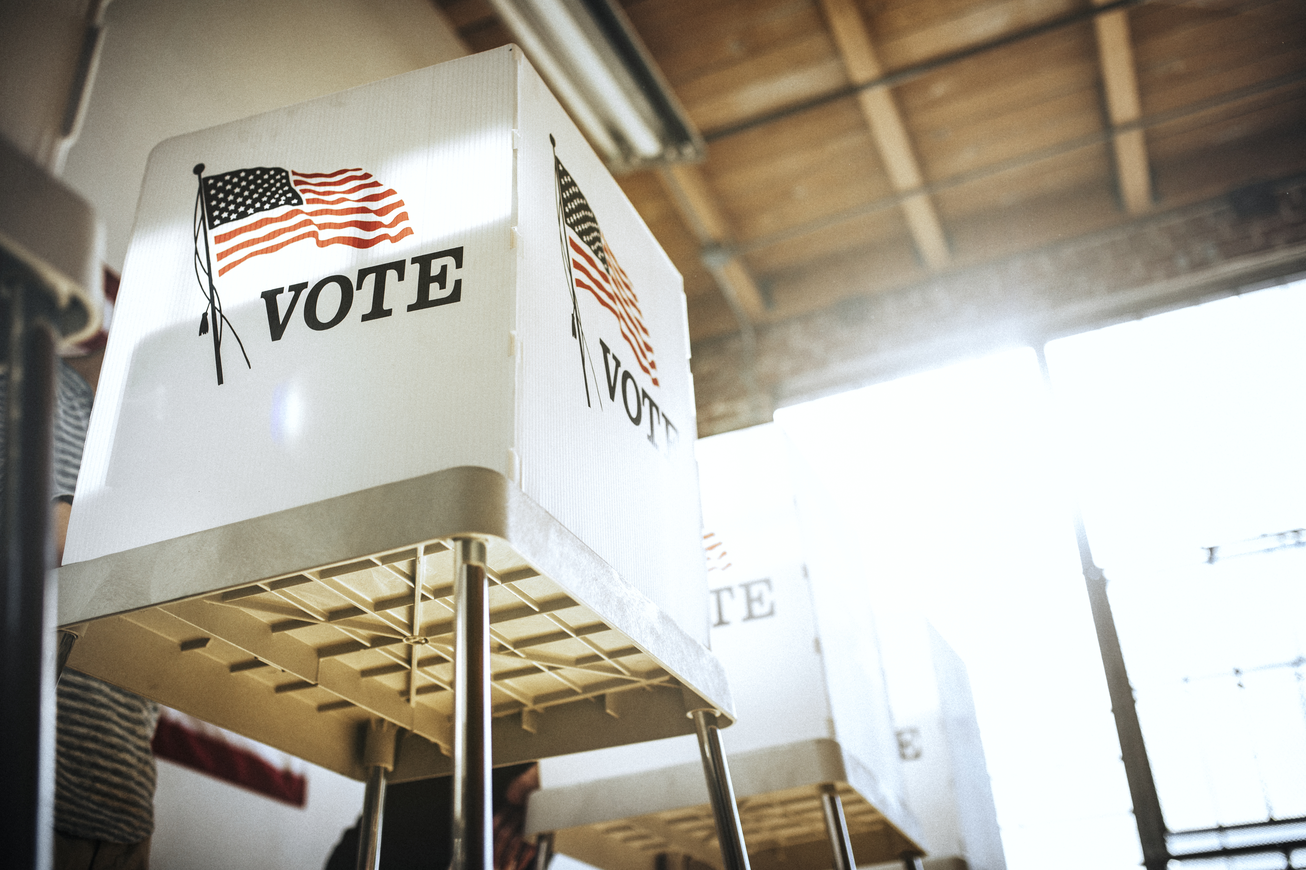


#PROTECT2024
OUR MISSION
Help election officials and election infrastructure stakeholders protect against the cyber, physical, and operational security risks to election infrastructure during the 2024 election cycle.

Slide 4
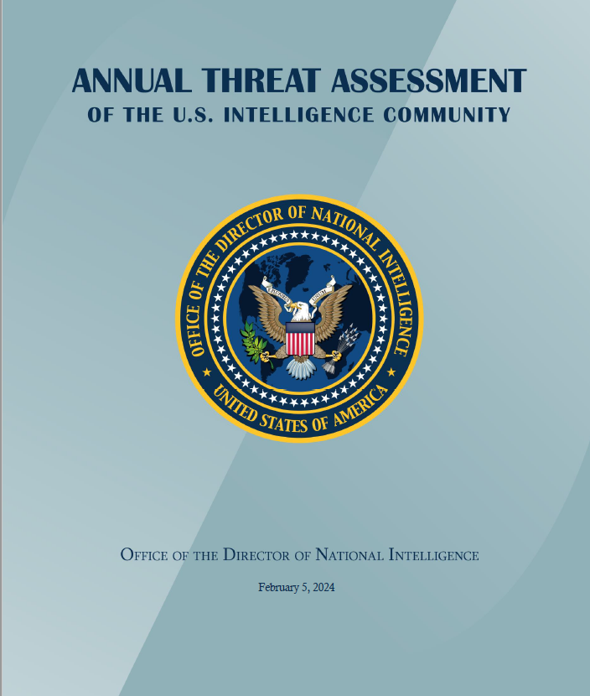
2024 ODNI Annual Threat Assessment
  Foreign Actors Likely to Target the 2024 Elections
  PEOPLE’S REPUBLIC OF CHINA
  “The PRC may attempt to influence the U.S. elections in 2024 at some level because of its desire to sideline critics of China and magnify U.S. societal divisions.”
  IRAN
  “Ahead of the U.S. election in 2024, Iran may attempt to conduct influence operations aimed at U.S. interests, including targeting U.S. elections, having demonstrated a willingness and capability to do so in the past.”
  RUSSIA
  “Moscow views U.S. elections as opportunities and has conducted influence operations for decades and as recently as the U.S. midterm elections in 2022.”

Slide 5
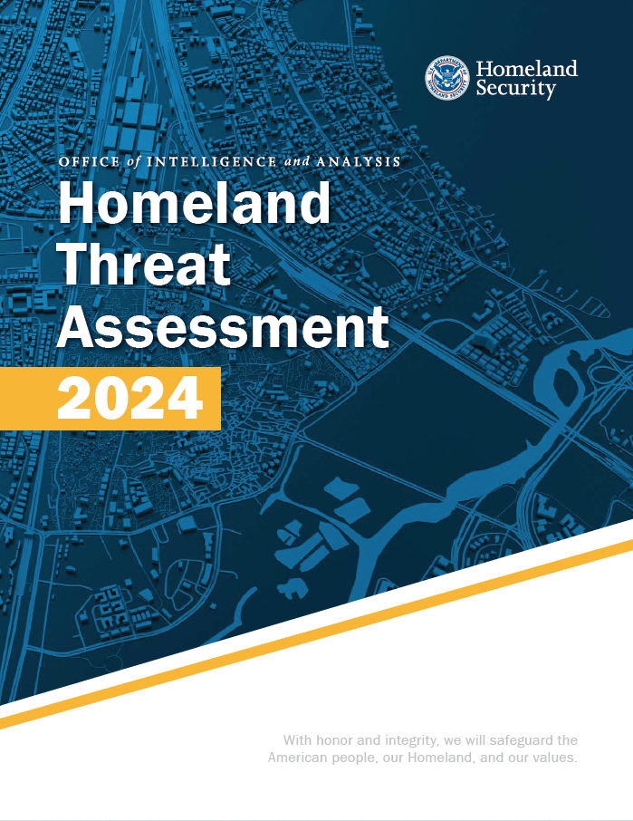
2024 DHS Homeland Threat Assessment
  Threat Actors Likely to Converge on 2024 Elections
  “We expect the 2024 election cycle will be a key event for possible violence and influence targeting election infrastructure, processes, and personnel.”
  “Our electoral processes remain an attractive target for many adversaries, and we expect many of them will seek to influence or interfere with the 2024 election.”
  “Some DVEs may attempt to disrupt civic and democratic processes, mobilized by their perceptions of the upcoming election cycle.”

Slide 6
Risks to Election Infrastructure
Violence and Harassment
Swatting
Hazardous Materials Distributed through the Mail
Insider Threats
Bomb Threats
PHYSICAL
Doxing
Ransomware
Hack and Leak
DDoS
CYBER
OPERATIONAL
High Turnover in Staff
Foreign Influence Operations
Environmental Disruptions

Slide 7


#PROTECT2024 First Things First
Simple steps election officials can still take to enhance their organization’s security baseline for the 2024 election cycle:
Enable Multi-Factor Authentication (MFA)
Know and manage your cyber vulnerabilities—Sign up for FREE Cyber Hygiene Services from CISA
Request a CISA physical security assessment
Transition to a .gov domain
Rehearse your incident response plan
Join the Election Infrastructure Information Sharing and Analysis Center (EI-ISAC)

Slide 8
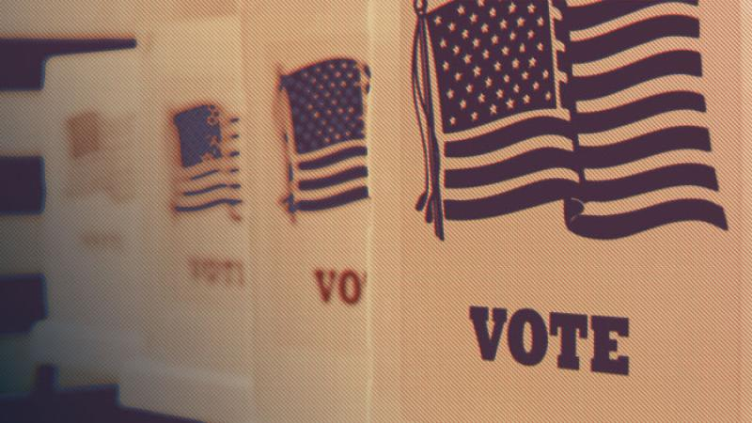



#Protect Your…
Email
Website
Network
  Election Systems
  Office
  Yourself and Your Staff

Slide 9
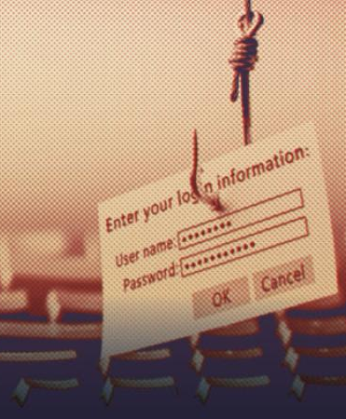

Protect Your Email
Phishing
  Mitigate phishing risks by:
    Using MFA
    Contacting EI-ISAC to implement endpoint security services (ESS) and malicious domain blocking and reporting (MDBR)
    Switching to a .gov domain
    Using CISA phishing mitigation guides and resources:
      Phishing Guidance: Stopping the Attack Cycle at Phase One
      Phishing Postcard
  Threats to Email and How to Protect Against Them

Slide 10

Protect Your Website
Denial-of-Service (DoS) and Distributed Denial-of-Service (DDoS)
  Mitigate DoS and DDoS risks by:
    Using CISA’s “No Downtime in Elections: A Guide to Mitigating Risks of Denial-of-Service”
    Contacting CISA to receive free web application scanning
    Check out free DDoS protection services offered by CISA’s private sector partners
Website Spoofing
  Mitigate website spoofing risks by:
    Switching to a .gov domain
  Threats to Websites and How to Protect Against Them

Slide 11
Protect Your Networks
Ransomware
  Mitigate ransomware risks by:
    Signing up for free CISA Cyber Hygiene Vulnerability Scanning
    Implementing ESS
    Leveraging Stop Ransomware Resources
    Deploying an Albert Intrusion Detection System
Business Email Compromise
  Protect against business email compromise by:
    Enabling MFA
    Implementing ESS
    Implementing MDBR
Exploiting Known Network Vulnerabilities
  Mitigate the exploitation of known network vulnerabilities by:
    Using CISA’s Known Exploited Vulnerabilities (KEV) Catalog
    Signing up for CISA’s free Cyber Hygiene Vulnerability Scanning
    Implementing ESS
    Deploying an Albert Intrusion Detection System
  Threats to Networks and How to Protect Against Them

Slide 12
Protect Your Election Systems
Insider Threats
  Mitigate risks of insider threats by:
    Implementing steps outlined in CISA’s “Election Infrastructure Insider Threat Mitigation Guide”
    Using the CISA Insider Threat training video, “Understanding the Insider Threat”, to inform and prepare your staff
Physical Compromise
  Mitigate risks of physical compromise by:
    Referencing “CISA Insights: Chain of Custody and Critical Infrastructure Systems”
Cyber Threats
  Mitigate risks of cyber threats by:
    Referencing CISA’s “Best Practices for Securing Election Systems”
    Implementing ESS
  Threats to Election Systems and How to Protect Against Them

Slide 13
Protect Yourself and Your Staff
Doxing
  Protect against doxing by:
    Referencing “CISA Insights on Mitigating the Impacts of Doxing on Critical Infrastructure”
    Implementing the “Personal Security Considerations Action Guide for Critical Infrastructure Workers”
Foreign Influence Operations
  Mitigate against foreign influence operations by implementing measures recommended in:
    CISA’s Insights on Generative AI-Enabled Threats Guide
    CISA’s Deepfake Threat Contextualization Guide
  Potential Threats to You or Your Staff and How to Protect Against Them

Slide 14
Protect Your Office
Mailing of hazardous materials to election offices
  Address the risk against mailing of hazardous materials by:
    Referencing CISA’s “Election Mail Handling Procedures to Protect against Hazardous Materials” to identify and safely handle suspicious mail
    Utilizing resources provided by the U.S. Postal Inspection Service (USPIS) for handling suspicious mail
Physical acts of violence against election offices and personnel
  Mitigate against physical acts of violence by:
    Providing “Non-confrontational Techniques for Election Workers Training” for your staff and poll workers
    Reaching out to CISA to request a Security Assessment at First Entry (SAFE) for your election office and supporting facilities
    Requesting specific virtual or in-person Election Security Trainings offered by CISA
    Referencing CISA’s “Physical Security of Voting Locations and Election Facilities” guidance
    Referencing CISA’s “Personal Security Considerations for Critical Infrastructure Workers” guidance
  Threats to Office and How to Protect Against Them

Slide 15
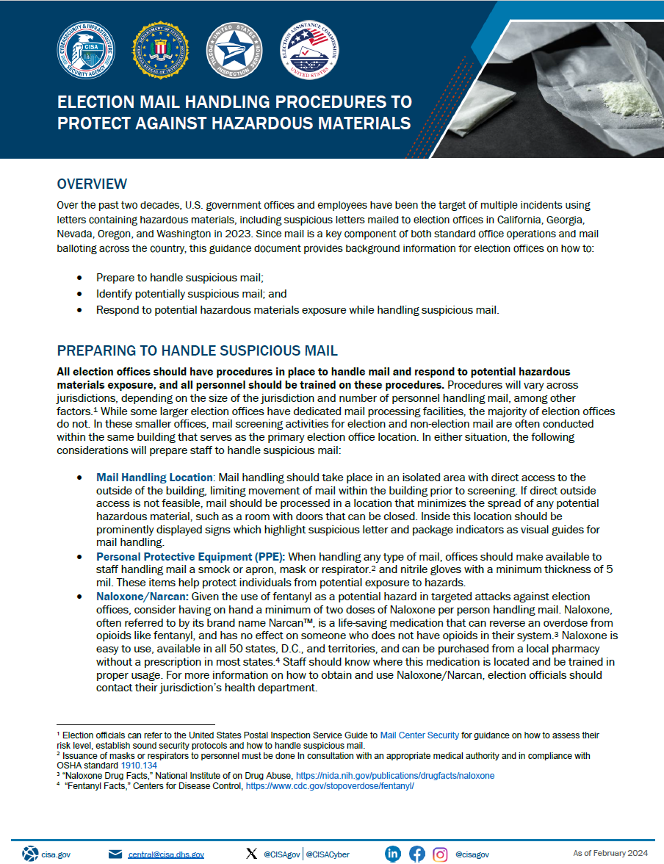
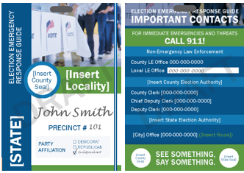
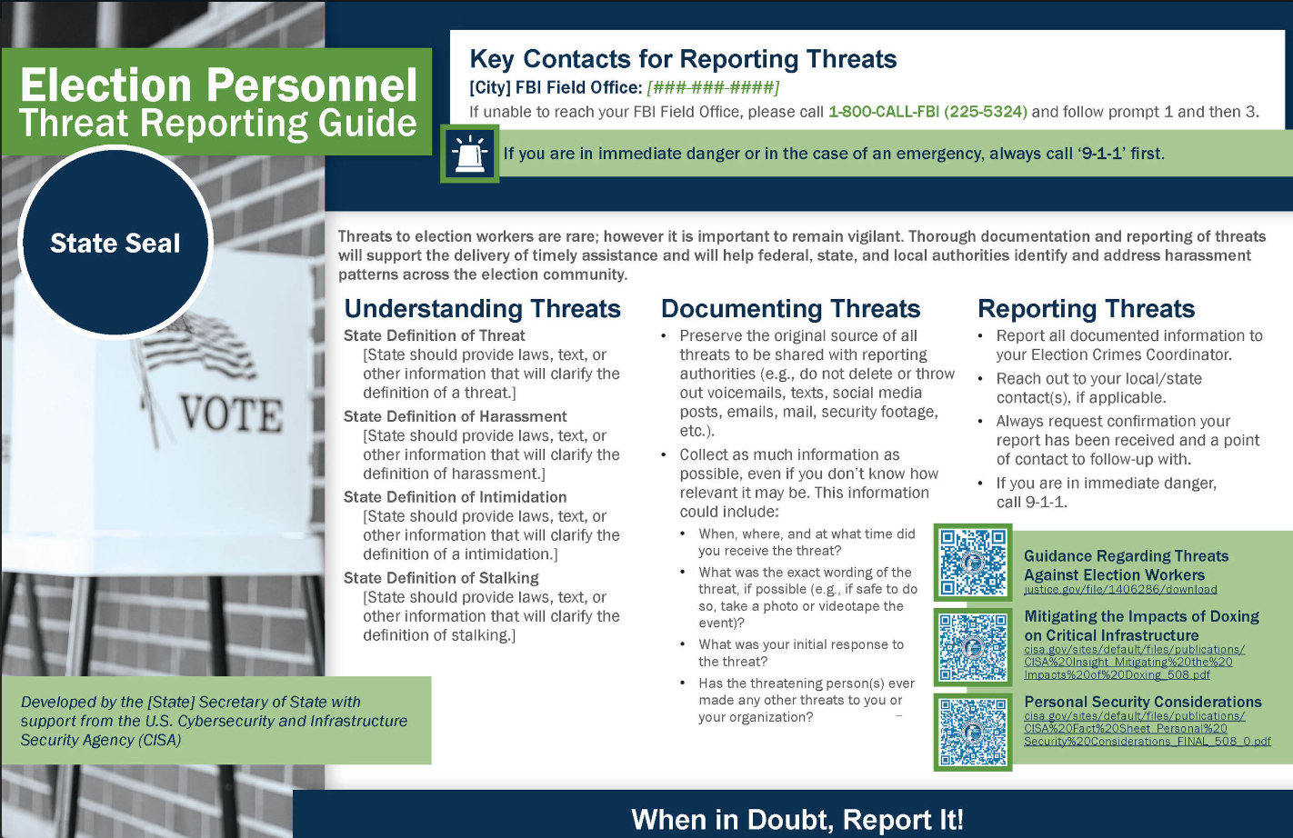
#PROTECT2024: CISA SERVICE SUPPORT
Best Practice Security Guidance to Mitigate Physical, Cyber and Operational Threats to Election Infrastructure
  Current and upcoming products that address emerging threats
  Current and upcoming products that provide actionable solutions for local jurisdictions
CISA Cybersecurity Services
  Cyber Hygiene Services
  Dot.Gov Transition
  In-Person and virtual Cyber Security Assessments
Partner Services Funded by CISA
  EI-ISAC Services: Endpoint Security Solutions, Malicious Domain Blocking and Reporting, Albert Sensors
Physical Security Assessments
Incident Response Management Assistance

Slide 16
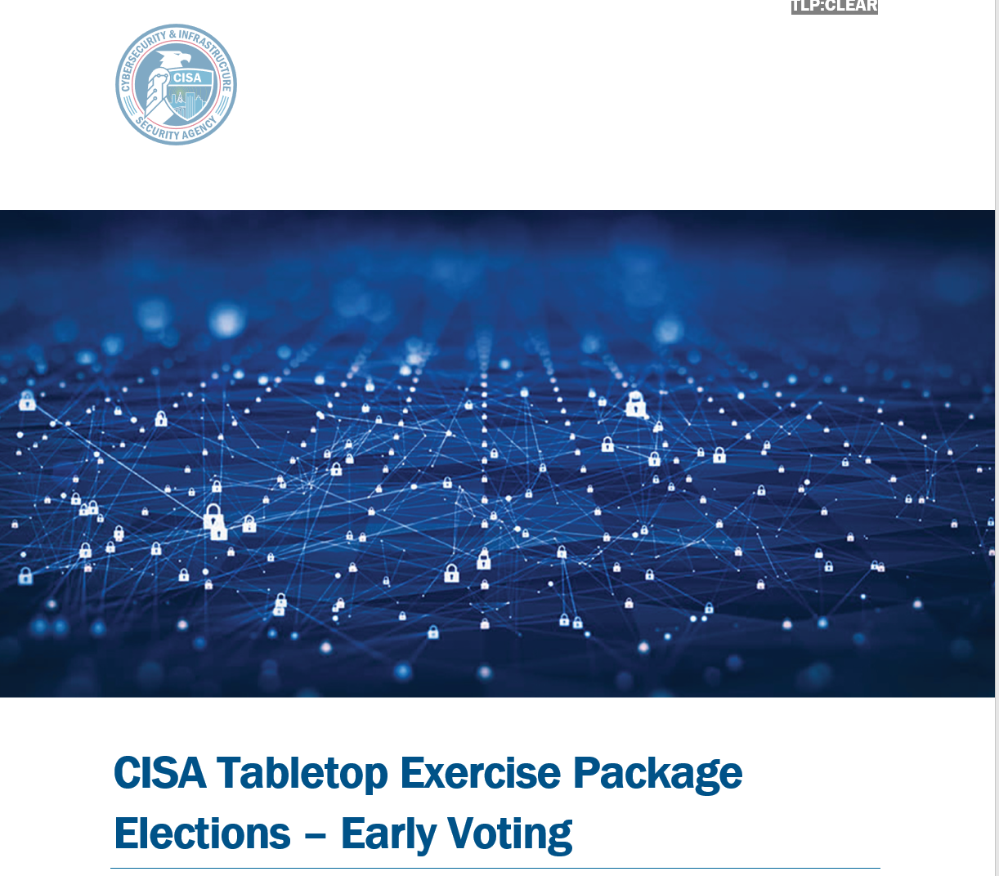
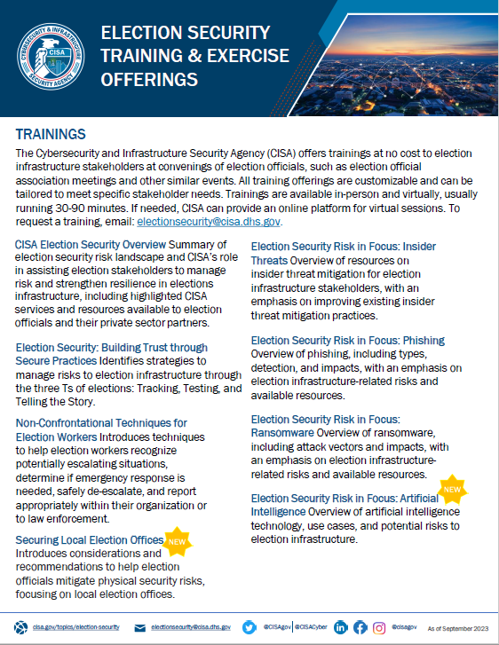
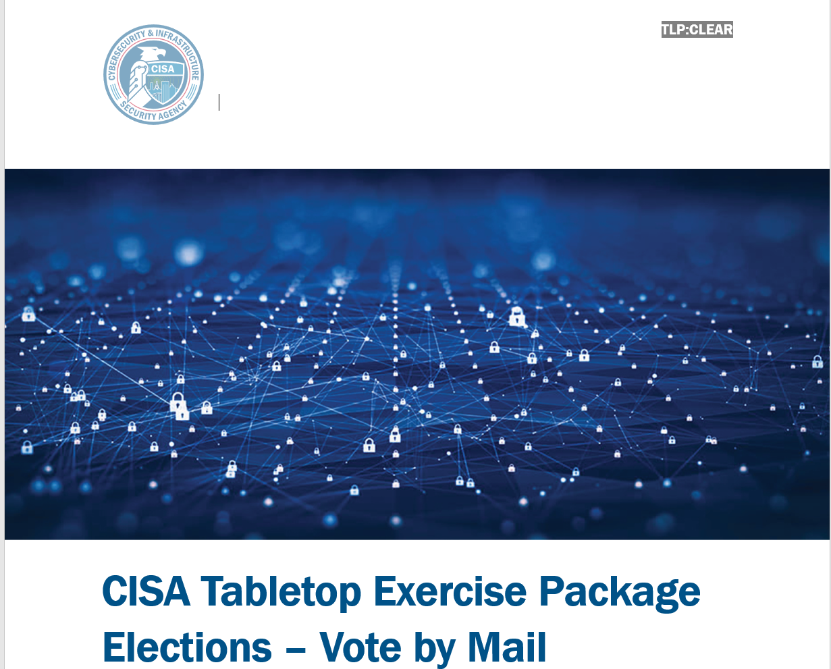
#PROTECT2024: CISA TRAINING SUPPORT
Ready to Use Training Videos on Our Website
In Person or Virtual Training Offerings
  Generative Artificial Intelligence
  Securing Local Election Offices
  Ransomware
  Building Trust through Secure Practices
  Non-Confrontational Techniques
  Insider Threats
  Phishing
Tabletop Exercises
  In-person state and local
  Annual National Tabletop the Vote
  TTX in a Box (Ready to Use TTX Guides for 3 Different Election Scenarios updated for the 2024 threat environment)

Slide 17
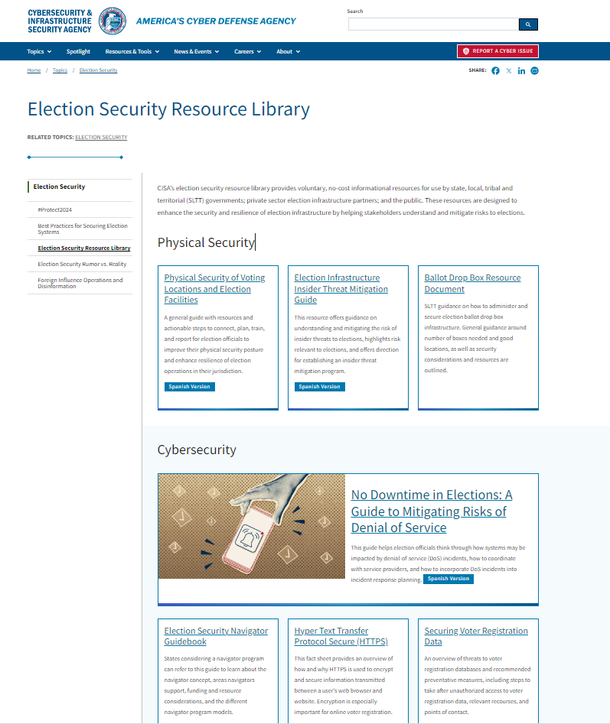
#Protect2024 Election Security Resource Library
One stop shop for CISA’s free election security informational resources
Resource topics include:
  Physical Security
  Cybersecurity
  Operational Risk
  Foreign Influence Operations and Disinformation
  Election Infrastructure Subsector
  Joint Releases with Federal Partners
  Election Security Services
https://www.cisa.gov/topics/election-security/election-security-resource-library

Slide 18
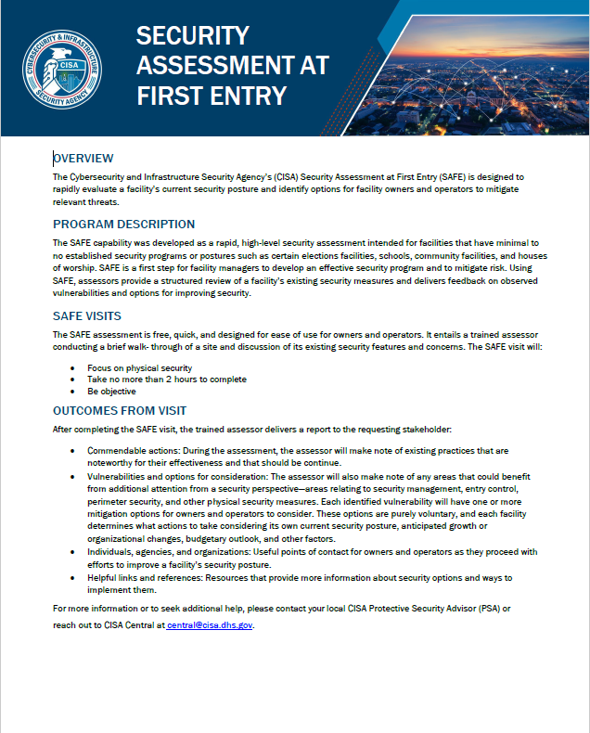
#Protect2024 Physical Security Tools / Resources
Physical Security Assessment Tools:
Securing Public Gatherings
Vehicle Ramming Self-Assessment Tool
Mass Gathering Security Planning Tool
Security Planning Workbook
SAFE Tool Assessment (SLTT)
Physical Security of Voting Locations and Election Facilities
https://www.cisa.gov/topics/election-security/election-security-resource-library

Slide 19
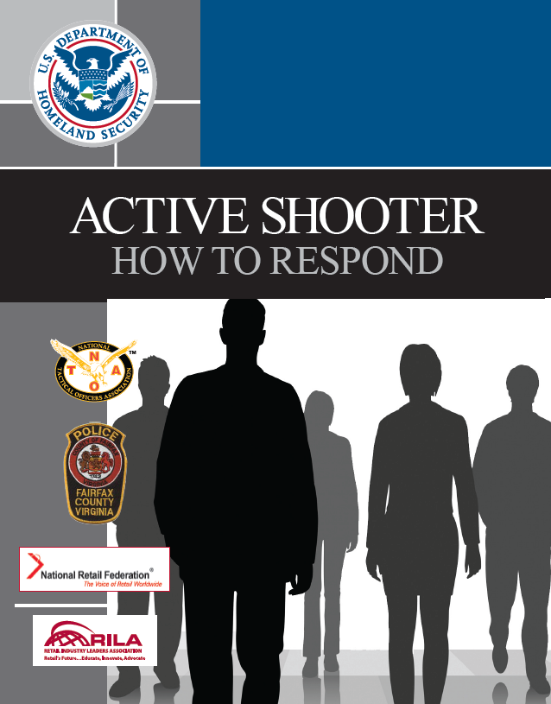
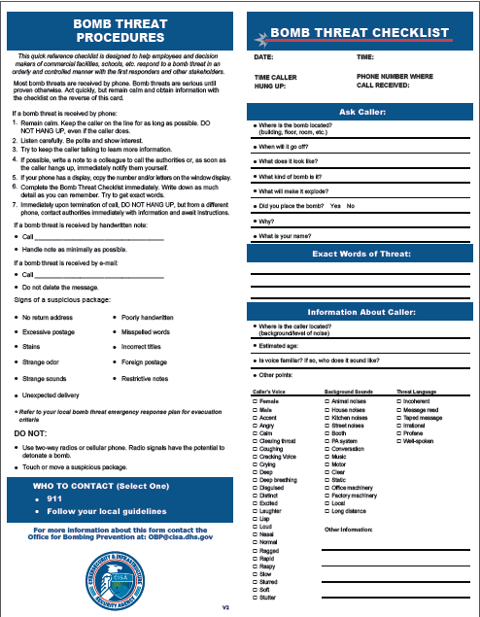
#Protect2024 Election Security Resources
Physical Security Resources
Active Shooter Preparedness
  DHS/CISA
  FBI
  LE
Bomb Threat Planning
  What to do in a bomb threat
  Training
  Bomb Threat Guide

Slide 20
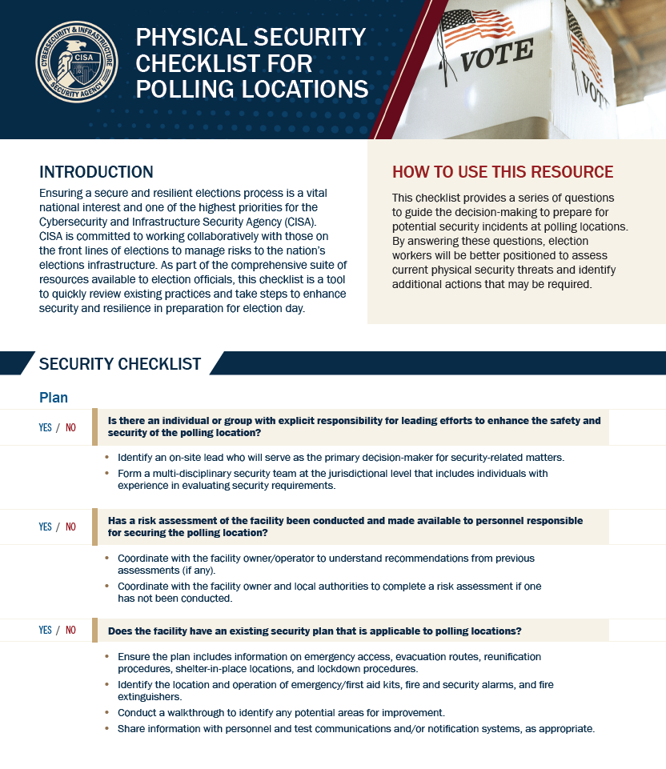
#Protect2024 Checklist for Polling Stations
Physical Security Checklist
  Identifying an individual or group responsible for security and safety.
  Utilizing risk assessments to inform security.
  Developing plans to inform processes and procedures.
  Refining security measures before election day.
  Implementing mitigations and “day of” security measures.
  Reporting suspicious behavior or potential incidents.
https://www.cisa.gov/topics/election-security/election-security-resource-library

Slide 21
Reporting
Contact CISA
Report incidents to:
  888-282-0870
  Central@cisa.dhs.gov
  https://www.cisa.gov/report
  What is an incident?
  A violation or imminent threat of violation of security policies, acceptable use policies, or standard security practices. Examples of incidents include:
  Attempts to gain unauthorized access to a facility, system or system data
  Unwanted disruption or denial of service
  Abuse or misuse of a system or data in violation of policy
  Physical disruptions to critical infrastructure operations
CISA Incident Management Assistance
  Provides incident response, management, and coordination activities for cyber incidents occurring in the critical infrastructure sectors as well as government entities at the Federal, State, Local, Tribal, and Territorial levels

Slide 22
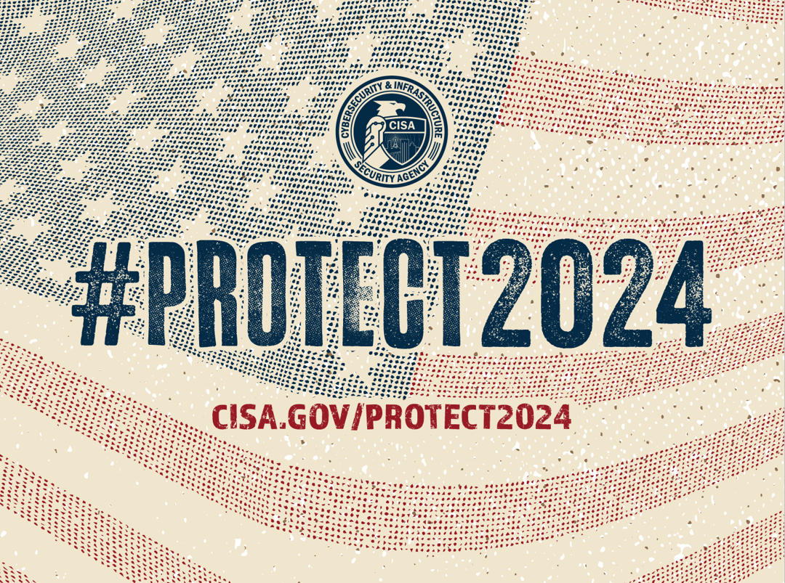
#PROTECT2024 Website
Specifically tailored for election officials to help them take full advantage of CISA’s services and resources
CISA.GOV/PROTECT2024

